Slide 1
Digital Design
Logic Gates

Slide 2
Logic Gates
A logic gate is an idealized model of computation or physical electronic device implementing a Boolean function, a logical operation performed on one or more binary inputs that produces a single binary output. Logic gates are one of the fundamental building blocks of digital systems.
NOT Gate
AND Gate
OR Gate
NAND Gate
NOR Gate
Exclusive-OR Gate
Exclusive-NOR Gate

Slide 3
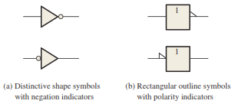
NOT Gate (Inverter)
The inverter (NOT circuit) performs the operation called inversion or complementation.
The inverter changes one logic level to the opposite level. In terms of bits, it changes a 1 to a 0 and a 0 to a 1.
Consists of one input and one output (Unary)

Slide 4

NOT Gate (cont.)
Inverter Operation: When the input is LOW, the output is HIGH; when the input is HIGH, the output is LOW, thereby producing an inverted output pulse.

Slide 5
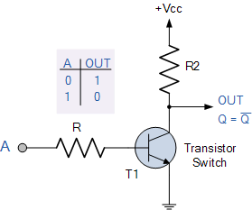
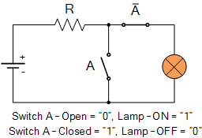
NOT Gate (cont.)
Truth Table and internal Circuit
The operation of an inverter (NOT circuit) can be expressed as follows: If the input variable is called A and the output variable is called X, then
Logic expression X = A̅ or X = A’
NOT gate representation through switch.

Slide 6
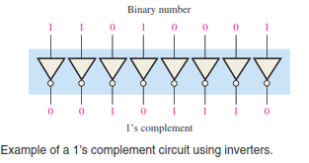
NOT Gate (cont.)
An application

Slide 7

AND Gate
An AND gate can have two or more inputs and performs what is known as logical multiplication
AND Gate Operation: An AND gate produces a HIGH output only when all the inputs are HIGH. When any of the inputs is LOW, the output is LOW.

Slide 8
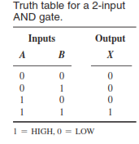
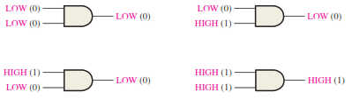

AND Gate (cont.)
For a 2-input AND gate, output X is HIGH only when inputs A and B are HIGH; X is LOW when either A or B is LOW, or when both A and B are LOW
The total number of possible combinations of binary inputs to a gate is determined by the following formula: N = $2^{n}$
Logic Expressions for an AND Gate X = A.B

Slide 9
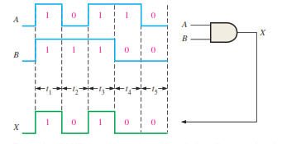
AND Gate (cont.)
AND Gate Operation with Waveform Inputs

Slide 10
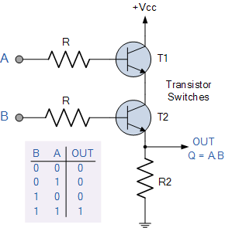
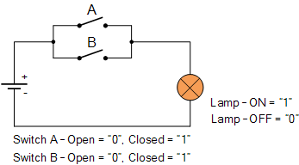
AND Gate (cont.)
AND Gate internal Circuit
Implementation through switches

Slide 11
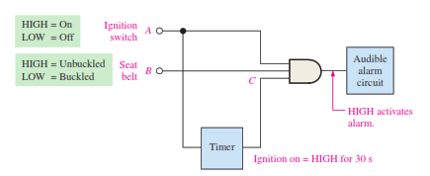
Application
AND gate is used in a simple automobile seat belt alarm system to detect when the ignition switch is on and the seat belt is unbuckled.

Slide 12

OR Gate
An OR gate can have two or more inputs and performs what is known as logical addition.
An OR gate produces a HIGH on the output when any of the inputs is HIGH.

Slide 13
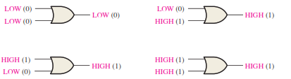
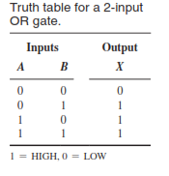
OR Gate (cont.)
For a 2-input OR gate, output X is HIGH when either input A or input B is HIGH, or when both A and B are HIGH; X is LOW only when both A and B are LOW
Truth Table
Logic expression: X = A + B
1 + 1 = 1 A OR’ed with itself is always equal to 1

Slide 14
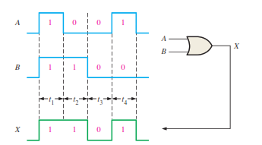
OR Gate (cont.)
OR Gate Operation with Waveform Inputs

Slide 15
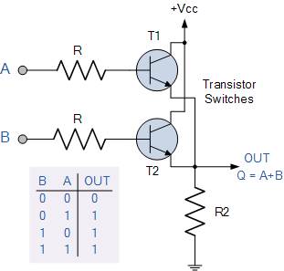
OR Gate (cont.)
Internal Circuit Diagram
Implementation Through switches

Slide 16
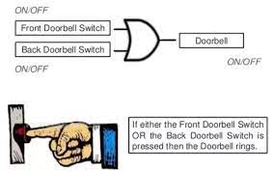
OR Gate (cont.)
An Application

Slide 17

NAND Gate
The NAND gate is a popular logic element because it can be used as a universal gate; that is, NAND gates can be used in combination to perform the AND, OR, and inverter operations.
The term NAND is a contraction of NOT-AND and implies an AND function with a complemented (inverted) output.

Slide 18
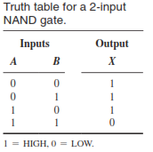
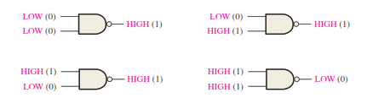
NAND Gate (cont.)
A NAND gate produces a LOW output only when all the inputs are HIGH. When any of the inputs is LOW, the output will be HIGH.
For a 2-input NAND gate, output X is LOW only when inputs A and B are HIGH; X is HIGH when either A or B is LOW, or when both A and B are LOW.
Logic expression: X = A̅.B̅ or X= A’.B’

Slide 19
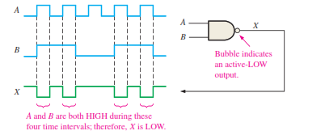
NAND Gate Operation with Waveform Inputs

Slide 20
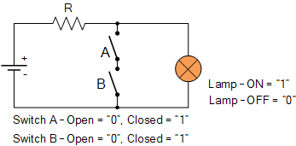
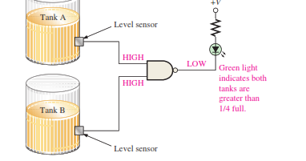
NAND Gate (cont.)
Implementation Using Switches
An application (As long as both sensor outputs are HIGH (5 V), indicating that both tanks are more than one-quarter full, the NAND gate output is LOW (0 V). The green LED circuit is connected so that a LOW voltage turns it on).

Slide 21
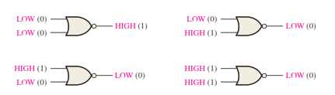

NOR Gate
The NOR gate, like the NAND gate, is a useful logic element because it can also be used as a universal gate; that is, NOR gates can be used in combination to perform the AND, OR, and inverter operations.
A NOR gate produces a LOW output when any of its inputs is HIGH. Only when all of its inputs are LOW is the output HIGH.

Slide 22
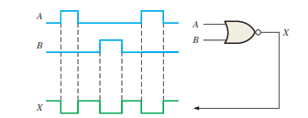
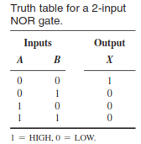
NOR Gate (cont.)
NOR Gate Operation with Waveform Inputs
Truth Table
Logic Expression: X= A̅ + B̅ or X = A’ + B’
Implementation Using Switches

Slide 23
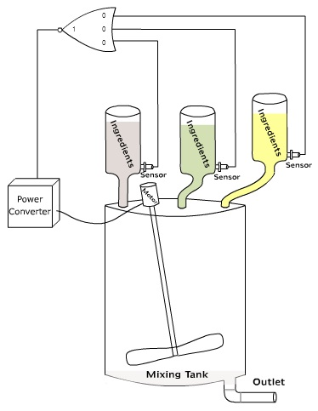
NOR Gate (cont.)
When all the ingredients comes down to the sensor level, the output of NOR gate will become HIGH. This output is connected to the Power converter and this power converter is connected to the Motor (to mix the ingredients). The HIGH output of the NOR logic gate activates the power converter and activates the motor, making the motor to run and mix all the ingredients

Slide 24
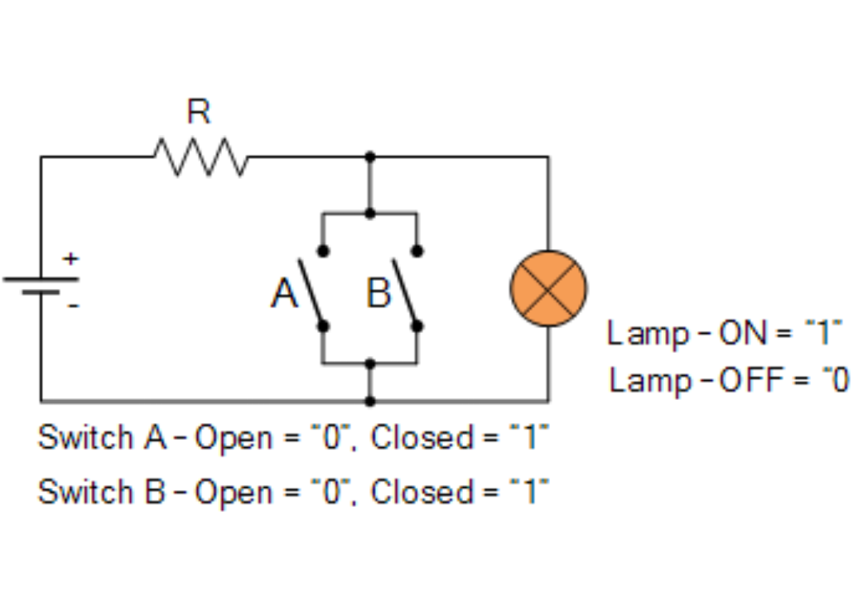
NOR Gate (cont.)
Implementation Using Switches

Slide 25
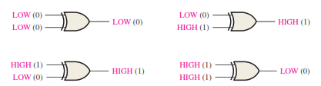
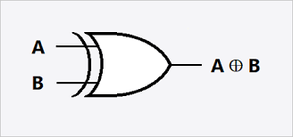

Exclusive-OR Gate (XOR)
The exclusive-OR gate performs modulo-2 addition
For an exclusive-OR gate, output X is HIGH when input A is LOW and input B is HIGH, or when input A is HIGH and input B is LOW; X is LOW when A and B are both HIGH or both LOW.
Logic Expression:

Slide 26
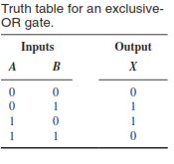
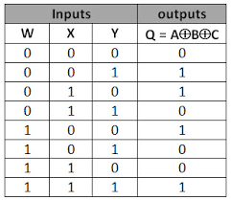
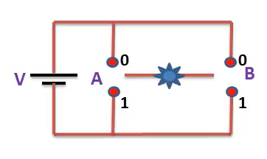
XOR Gate (cont.)
Truth Table (two input)
3 input truth Table
When the number of 1’s is even the output is high and when the number of 1’s is odd the output is low.
Implementation using switches

Slide 27

XOR Gate (cont.)
The outputs of the circuits are connected to the inputs of an XOR gate as shown in Figure. A failure in either one of the circuits produces differing outputs, which cause the XOR inputs to be at opposite levels. This condition produces a HIGH on the output of the XOR gate, indicating a failure in one of the circuits

Slide 28

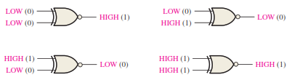
The Exclusive-NOR Gate (XNOR)
The bubble on the output of the XNOR symbol indicates that its output is opposite that of the XOR gate. When the two input logic levels are opposite, the output of the exclusive-NOR gate is LOW.
For an exclusive-NOR gate, output X is LOW when input A is LOW and input B is HIGH, or when A is HIGH and B is LOW; X is HIGH when A and B are both HIGH or both LOW.

Slide 29
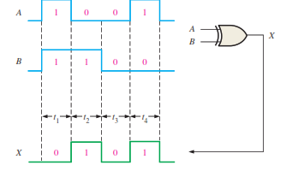
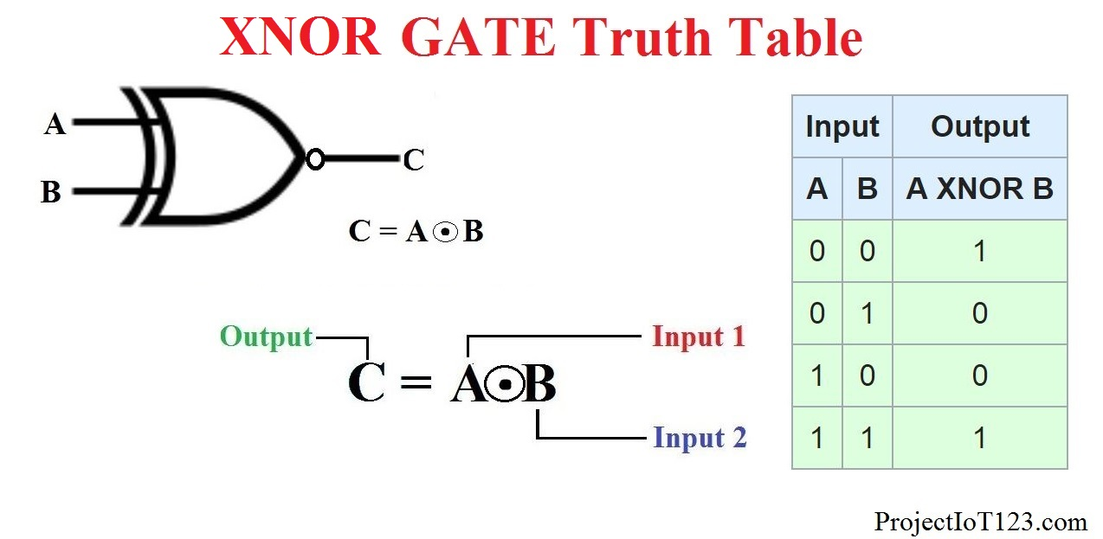
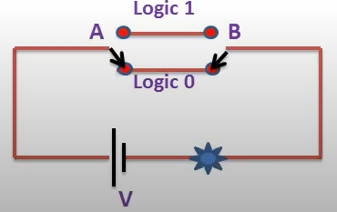
XNOR Gate (cont.)
Operation with Waveform Inputs
Logic Expression
Implementation Using Switches

Slide 30
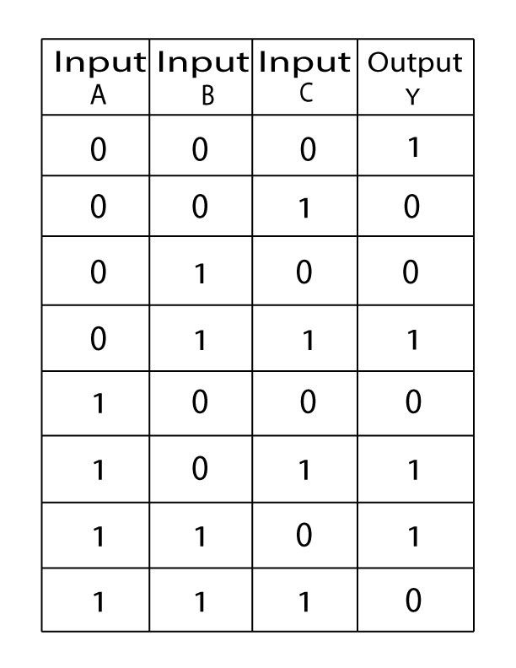
XNOR Gate (cont.)
Three input truth Table
When the number of 1’s is even the output is high and when the number of 1’s is odd the output is low.
Implementation Using Switches

Slide 31
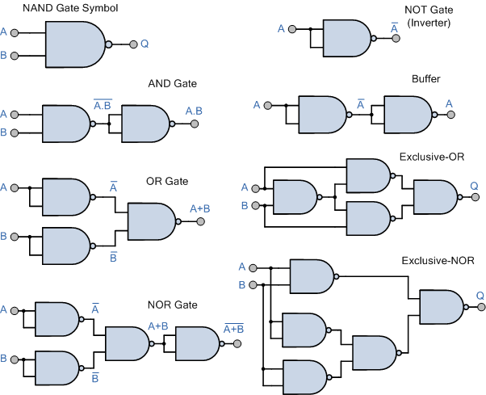
Universal Gates
NAND gates can be used in combination to perform the AND, OR, and inverter operations.

Slide 32
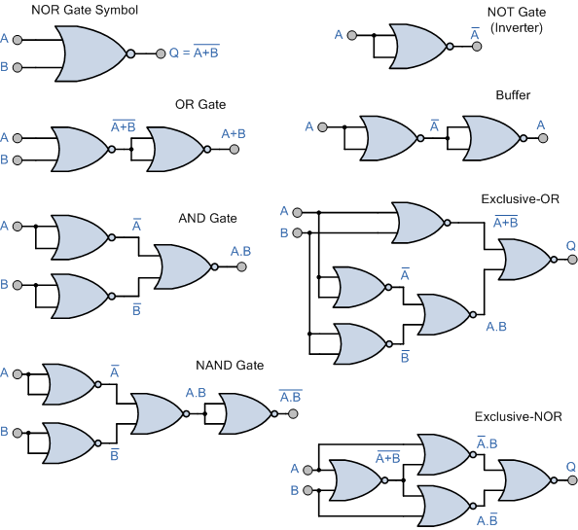
Implementation of gates Using Universal Gates (cont.)
NOR gates can be used in combination to perform the AND, OR, and inverter operations.

